Slide 1

Process Mining Virtual Internship
by
J.Jagadabhiram Sharwan
Roll No. 214G1A3227
Department of Computer Science and Engineering (Data Science)
Srinivasa Ramanujan Institute of Technology
(Affiliated to JNTUA & Approved by AICTE) (Accredited by NAAC with ‘A’ Grade & Accredited by NBA (EEE, ECE & CSE)
Rotarypuram Village, B K Samudram Mandal, Ananthapuramu – 515701.
2023 - 2024

Slide 2

Contents
Course Objective
Introduction
Technology
Applications
Modules
Real Time applications
Learning outcomes
GitHub Link
Queries

Slide 3
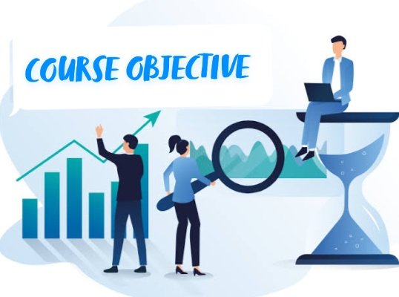
Course Objective
The primary objective of the course is to ensure that students gain a solid understanding of the fundamental concepts, principles, and methodologies of process mining.
The second main objective is to enable students to apply their acquired knowledge to real-world scenarios and datasets.

Slide 4


INTRODUCTION
About celonis:
Celonis is a leading software company that specializes in process mining and process excellence solutions.
It was founded in 2011 by Bastian Nominacher,
Martin Klenk, and Alexander Rinke in Germany.

Slide 5
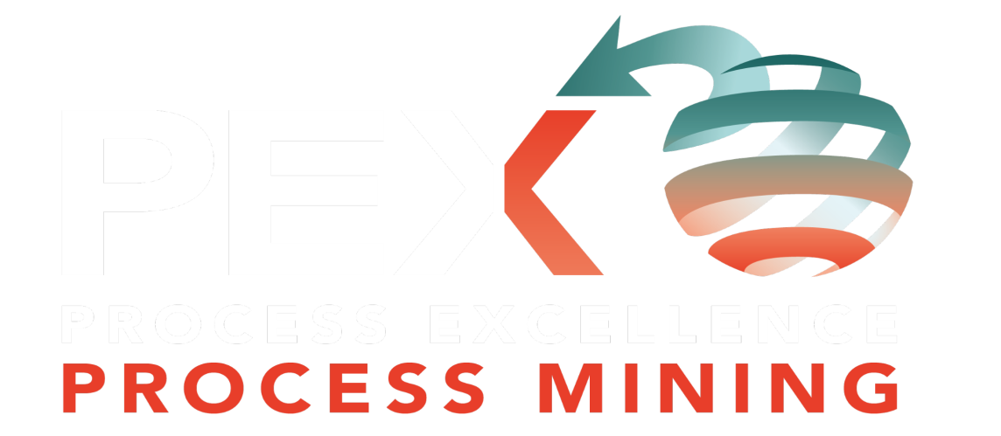
contd..
WHAT IS PROCESS MINING?
Process mining is a data-driven approach that aims to discover, analyze, and improve real business processes using information extracted from event logs.
It involves the extraction of insights and knowledge about how processes are actually executed within an organization.
Process mining starts with process discovery, where algorithms analyze event logs to generate process models that represent the actual sequence of activities, decisions, and interactions within a process.

Slide 6
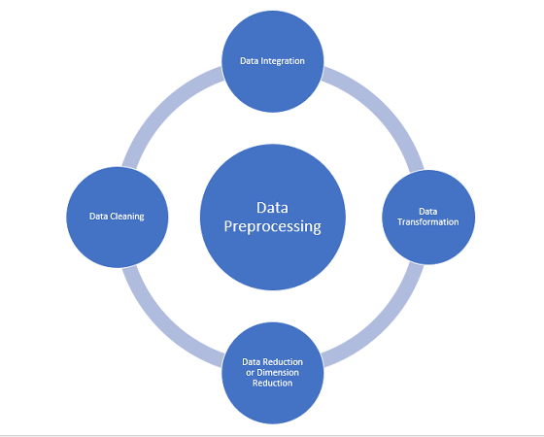
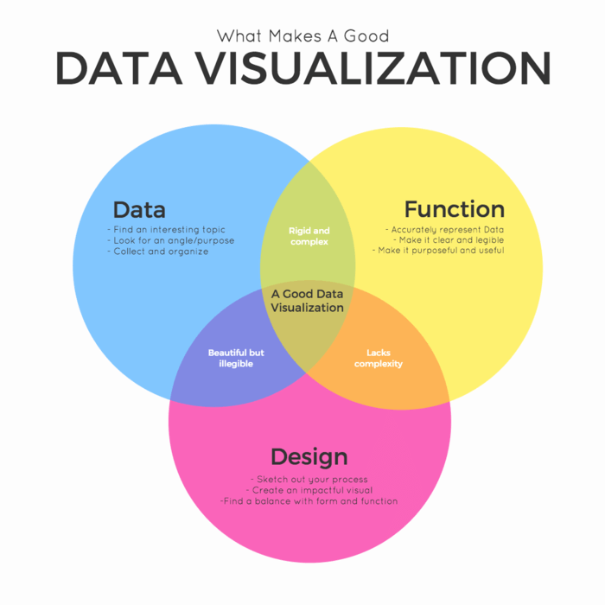
TECHNOLOGY
Data Preprocessing: Before analysis can begin, event logs often need to be cleaned and preprocessed. This might involve removing duplicates, handling missing data, and transforming raw data into a more suitable format for analysis.
Data Visualization: Interactive visualizations play a crucial role in process mining. They help stakeholders understand complex process behaviors, bottlenecks, and other patterns.

Slide 7
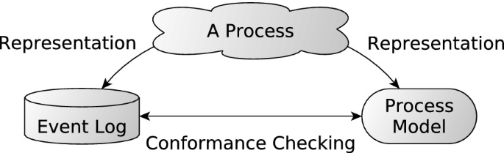
APPLICATIONS
Process Discovery: Process discovery is one of the fundamental applications of process mining. It involves analyzing event logs and automatically generating visual representations of how processes are executed in reality.
Conformance Checking: Conformance checking is a crucial application of process mining that involves comparing the actual execution of processes with the intended or expected behavior of those processes.

Slide 8
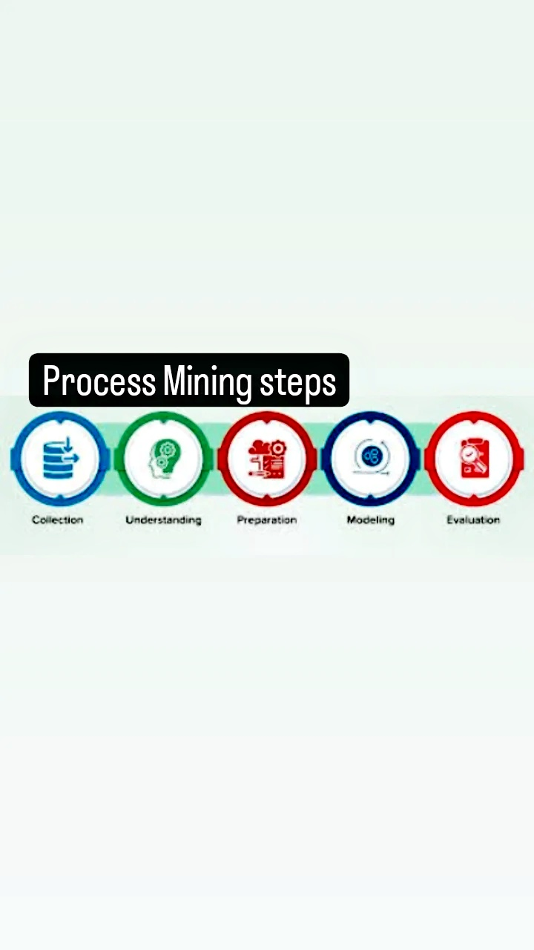
MODULES
STEPS INVOLVED IN PROCESS MINING:
Data Collection
Data Understanding
Data Preparation
Data Modeling
Data Evaluating

Slide 9
contd..
Data collection: It involves gathering event data from various sources within an organization's information systems, databases.
Data understanding: Data understanding in process mining refers to the process of gaining a comprehensive understanding of the data that will be used for analysis.
Data preparation: It is a crucial step in the process mining workflow. It involves transforming and structuring the raw event data into a suitable format for analysis.
Data modeling: Data modeling in process mining refers to the creation of graphical representations or mathematical models that capture the behavior, structure, and characteristics of business processes using the event data collected.
Data evaluating: In the context of process mining, data evaluation involves assessing the quality, relevance, and appropriateness of the data before and during the analysis.

Slide 10
REAL TIME EXAMPLES
Patient Journey Analysis: Examining electronic health records and medical device data to visualize patient treatment paths, uncover treatment variations, and enhance care coordination.
Loan Application Processing: Analyzing the loan approval process to identify areas of inefficiency and reduce the time taken for loan processing.
Returns and Refunds Process: Identifying the reasons for returns, processing times, and customer interactions to optimize the returns process and reduce return rates.
Public transportation: It generate a vast amount of data from various sources, such as ticketing systems, GPS tracking devices on vehicles, passenger counting sensors, and more.

Slide 11



contd..
Examples:

Slide 12
LEARNING OUTCOMES
It improve problem soving skills of students
It is a technique used to analyze and visualize processes based on event data recorded in information systems.

Slide 13
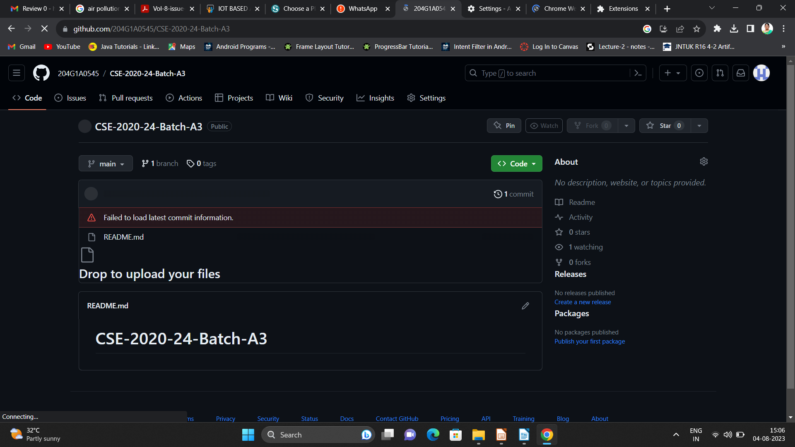

Git Hub Dashboard
Repository Name Like: Summer Internship - I
Under that include document, presentation and Certificate(Pdf).

Slide 14
Any Queries?

Slide 15
Thank You!!!

